Slide 1

The reinvention of Italian cuisine in the Anglo-Saxon imagination
Esterino Adami
Department of Humanities
University of Turin
esterino.adami@unito.it

Slide 2
Outline of this talk
Idea of food discourse and cultural/social construction of food schema
Food in domains and texts (literature, language)
Food and identity
Italian lexical borrowings in English (food and drinks)
Food in the Victorian age
Italian food in utopian romance
Reinvention of Italian food: recipes

Slide 3
Introduction
2015 Milan-based World Expo, with the motto “Feeding the planet, energy for life”
Lévi-Strauss’ paradigm of ‘the raw and the cooked’ (1964): "certain categorical opposites drawn from everyday experience with the most basic sorts of things — e.g. 'raw' and 'cooked,' 'fresh' and 'rotten,' 'moist' and 'parched,' and others — can serve a people as conceptual tools for the formation of abstract notions and for combining these into propositions."
Food discourse for indexicality of identity

Slide 4
Italian food discourse
Popularity of Italian food: http://www.fedrest.com/italian.html
The University of Gastronomic Sciences, Pollenzo (Italy) http://www.unisg.it/en/
Idea of Slow food http://www.slowfood.com/
Cheese www.cheese.slowfood.com
Language (of food) as a social practice (Alistair Pennycook)
Methodology: cultural studies, literary studies, stylistics, comparative literature, critical discourse analysis

Slide 5
Food discourse and identity
idea of ‘Discourses’ (with capital letter) (Gee 1996)
‘major/minor’ identity categorization (Lakoff 2006)
Food discourse

Slide 6
Key words in food discourse
“real food”, “home-made”, “traditional” or “natural”
Authenticity, circulation and identity
Transformation, reinvention and hybridity of food
“Greek, Italian, Indian and Chinese food have been part of the English diet for decades” (Fox 2004: 300-301)
Transformation of food habits through time

Slide 7
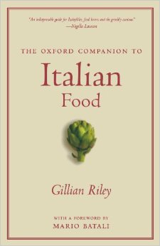
Italianisms:
Italian lexical borrowings in English from the domain of food/drink
Oxford English Dictionary: 704 lemmas of the semantic field of food and 29 lemmas of the semantic field of drinks
→ art (110) and music and song (334)

Slide 8
Food: Antipasto, broccoli, cannelloni, cassata, fettucine, fico, gnocchi, grissino, lasagne, linguine, manzo, minestra, minestrone, mortadella, mozzarella, panettone, pasta, pecorino, pesto, pistacchio, pizza, polenta, provolone, ravioli, ricotta, risotto, semola, spaghetti, stracchino, tagliatelle, tortellini, vermicelli, zucca, zucchini…
Drinks: Cappuccino, espresso, granita, grappa, malvasia, maraschino, Martini, moscato, Nebbiolo, rosolio, sambuca, vino, vinsanto…

Slide 9
Italian names of restaurants, eateries, cafes / dishes
In New York: like Dolce Vita (from the world of cinema), or like La Gioconda or Dante (from Italian art)
Restaurant’s names with a musical reference (Intermezzo) or a tourist indication (Firenze, Roma, San Pietro), or with terms typically considered as Italianisms like Babbo, Bella Mamma, Ciao, Al Dente Ristorante, or in other case connected with soccer (Azuri Cafè).
Dishes with Italian-sounding names (sound symbolism) like Farfalle al limoncello, Chicken scarpariello, Salsiccia San Gennaro.
Process of accommodation for the Spelling of these names, e.g. Dolche Vita cafè at the University of Kent (UK)

Slide 10
The Victorian age: C. Dickens
Hunger, food and abundance of food
The master, in his cook’s uniform, stationed himself at the copper; his pauper assistants ranged themselves behind him; the gruel was served out; and a long grace was said over the short commons. The gruel disappeared; the boys whispered each other, and winked at Oliver; while his next neighbours nudged him. Child as he was, he was desperate with hunger, and reckless with misery. He rose from the table; and advancing to the master, basin and spoon in hand, said: somewhat alarmed at his own temerity: “Please, sir, I want some more”.
Oliver Twist p 56 (1837-9)

Slide 11
Gruel vs Polenta
Gruel is a simple dish made by boiling oats in milk or water, eaten especially in the past by poor people
Polenta: mush made of chestnut meal, cornmeal, semolina or farina. Origin: Italian from Latin, crushed and hulled barley, akin to Latin pollen fine flour; first use 1764 (Merriam Webster online)
Flour of wheat, or milletor broad beans, or hulled wheat, or lupine, and in some regions even of rice or chestnuts

Slide 12
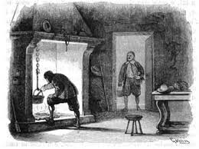
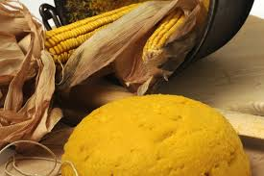
Polenta in Italian literature
I promessi sposi (1827) by Alessandro Manzoni (The Betrothed)
the spread of pellagra

Slide 13
Food galore
The Pickwick Papers (1836): 35 breakfasts, 10 lunches, 32 dinners and even 249 beverages
Cf. Pantagruel (Rabelais)
Pantagruelian / Gargantuan

Slide 14
Micro-details related to food
My sister had a trenchant way of cutting our bread-and-butter for us that never varied. First, with her left hand she jammed the loaf hard and fast against her rib […] Then she took some butter (not too much on a knife and spread it on the loaf, in an apothecary kind of way, as if she were making a plaster – using both sides of the knife with a slapping dexterity, and trimming and moulding the butter off round the crust. Then, she gave the knife a final smart wipe on the edge of the plaster, and then sawed a very thick round off the loaf: which she finally, before separating from the loaf, hewed into two halves, of which Joe got one, and I the other.
Great Expectations, p. 42 (1860-61)

Slide 15
Food during the Christmas time
It was his own room. There was no doubt about that. But it had undergone a surprising transformation. The walls and ceiling were so hung with living green, that it looked a perfect grove; from every part of which, bight gleaming berries glistened. The crisp leaves of holly, mistletoe, and ivy reflected back the light, as if so many little mirrors had been scattered there; and such a mightily blaze went roaring up the chimney, as that dull petrifaction of a hearth had never known in Scrooge’s time, or Marley’s, or for many and many a winter season gone. Heaped up on the floor, to form a kind of throne, were turkeys, geese, game, poultry, brawn, great joints of meat, sucking-pigs, long wreaths of sausages, mince-pies, plum-puddings, barrels of oysters, red-hot, chestnuts, cherry-cheeked apples, juicy oranges, luscious pears, immense twelfth cakes, and seething bowls of punch, that made the chamber dim with their delicious steam.
A Christmas Carol, p 45

Slide 16
Mrs Cratchit made the gravy (ready beforehand in a little saucepan) hissing hot; Master Peter mashed the potatoes with incredible vigour; Miss Belinda sweetened up the apple sauce; Martha dusted the hot plates; Bob took Tiny Tim beside him in a tiny corner at the table; the two young Cratchits set chairs for everybody, not forgetting themselves, and mounting guard around their posts, crammed spoons into their mouths, lest they should shriek for goose before their turn came to be helped. At last the dishes were set on, and grace was said. It was succeeded by a breathless pause, as Mrs Critchit, looking slowly all along that carving knife, prepared to plunge it in the breast; but when she did, and when the long expected gush of stuffing issued forth, one murmur of delight arouse all around the board, and even Tiny Tim, excited by the two young Cratchits, beat on the table with the handle of his knife, and feebly cried Hurrah!
A Christmas Carol, p. 53-4

Slide 17
Italian cakes and desserts of the Christmas period
panettone: a dome-shaped Christmas cake from Milan, filled with raisins and candied peel, pandoro: a buttery vanilla-flavoured Christmas cake from Verona, star-shaped and sprinkled with powdered sugar.
In the area around Brescia, for example, Saint Lucy brought gifts to the children and they prepared ‘Saint Lucy’s dish’, which consisted of biscuits and milk.
pan giallo (traditional Christmas cake from Rome made with corn meal, raisins, almonds and nuts – in Lazio coloured with saffron), pan pepato (traditional cake from central Italy, made with flour, toasted almonds, plain cocoa, sugar, honey, mixed candied peel, cinnamon powder, cloves, pepper and plain chocolate), pan speziale (Carthusian bread, Christmas bread with nuts and chocolate from Bologna; originally prepared by carthusians (Cf. gingerbread), or panforte (traditional heavy spiced cake from Siena filled with candied peel and walnuts).

Slide 18
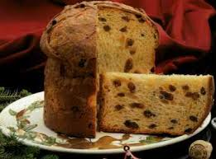
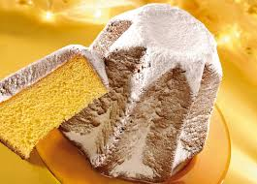

Slide 19
Christmas pudding
a 14th century porridge called 'frumenty‘, made of beef and mutton with raisins, currants, prunes, wines and spices
customary Christmas dessert around 1650, banned as a bad custom in 1664 by the Puritans
In 1714, King George I re-established it as part of the Christmas meal,
Superstitions surrounding Christmas Puddings:
the pudding should be made with 13 ingredients to represent Jesus and His Disciples
The decorative sprig of holly on the top of the pudding is a reminder of Jesus' Crown of Thorns that he wore when he was killed.
In the Middle Ages, holly was also thought to bring good luck and to have healing powers. It was often planted near houses in the belief that it protected the inhabitants.

Slide 20
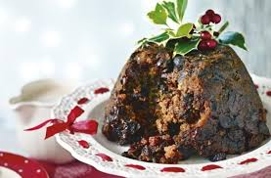
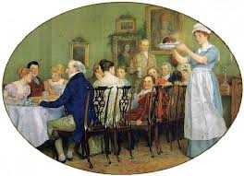
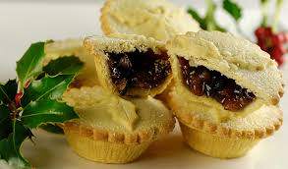

Slide 21
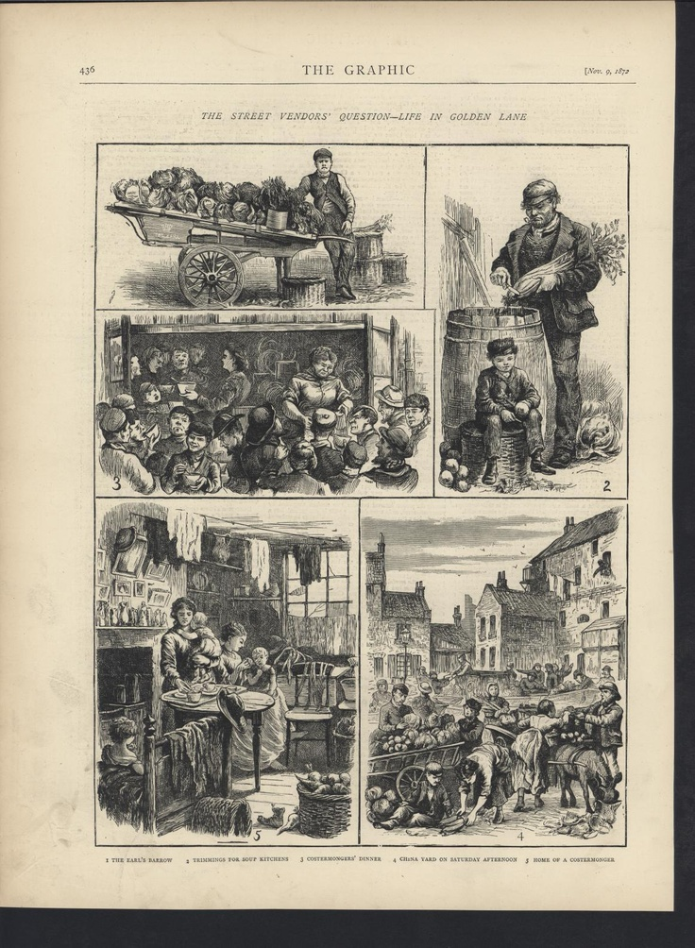
Food in Dickens’ non fiction
Street food
Restaurant experience

Slide 22
[…] little deal tables, with the ordinary preparations for a street breakfast, make their appearance at the customary stations. Numbers of men and women (principally the latter), carrying upon their heads heavy baskets of fruit, toil down the park side of Piccadilly, on their way to Covent Garden, […]. Here and there, a bricklayer’s labourer with the day’s dinner tied up in a handkerchief, walks briskly to his work, […] basket-women talking, piemen expatiating on the excellence of their pastry.
Skeches by Boz, 48-9

Slide 23
In the suburbs, the muffin boy rings his way down the little street, […] for Mrs Macklin, of n. 4, has no sooner opened her little street-door, and screamed out ‘Muffins!’ with all her might, than Mrs Walker, at n. 5, puts her head out of the parlour, and screams ‘Muffins!’ too; and Mrs Walker has scarcely got the words out of her lips, than Mrs Peplow, over the way, lets loose Master Peplow, who darts down the street, with a velocity which nothing but buttoned muffins in perspective could possibly inspire, and drags the boy back by main force, whereupon Mrs Macklin and Mrs Walker, just to save the boy trouble, and to say a few neighbourly words to Mrs Peplow at the same time, run over the way and buy their muffins at Mrs Peplow’s door.
Skeches by Boz, 53

Slide 24
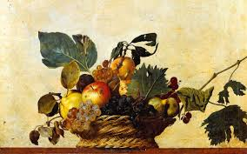
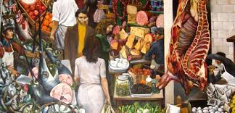
Cf. textual and chromatic effects
Canestra di frutta by Caravaggio (1599)
  Guttuso’s Vucciría (1974)

Slide 25
On the streets of London
“flat-fish, oyster and fruit vendors” as well as other peddlers “a cheesemonger offering huge piles of bright red and pale yellow cheeses, mingled with little fivepenny dabs of dingy bacon, various tubs of weekly Dorset, and cloudy rolls of best fresh” and also “the baked-potato man” (p. 55).
“houses of refreshment”, in which “chops, kidneys, oysters, stout, cigars, and ‘goes’ innumerable, are served up amidst a noise and a confusion of smoking, running, knife-clattering and waiter chattering, perfectly indescribable” (p. 56).
food discourse as a wealth of lexical items, a list of linguistic variations, but for the Italian writer Italo Calvino it is also a ‘mental, aesthetic and symbolic’ temptation or gluttony (evocative power of names)

Slide 26
Restaurants
I travel by railroad. I start from home at seven or eight in the morning, after breakfasting hurriedly […] I am hungry when I arrive at the ‘Refreshment’ station where I am expected. Please to observe, expected. I have said, I am hungry; perhaps I might say, with greater point and force, that I am to some extent exhausted, and that I need – in the expressive French sense of the word – to be restored. What is provided for my restoration? I turn my disconsolate eyes on the refreshments that are to restore me. I find that I must either scald my throat by insanely ladling into it, against time and for no wager, brown hot water stiffed with flour; or I must make myself and sick and Banbury cake; or I must stuff into my delicate organisation, a currant pincushion which I know will swell into immeasurable dimensions when it has got there; or I must extort from an iron-bound quarry, with a fork, as if I were farming an inhospitable soil, some glutinous lumps of gristle and grease, called pork-pie. While thus forlornly occupied, I find that the depressing banquet on the table is, in every phase of its profoundly unsatisfactory character, so like the banquet at the meanest and shabbiest of evening parties.
Refreshments for travellers, p 76-7

Slide 27
Banquet
Plato’s Symposium to Xenophon’s Symposium, but also Erasmus’ Colloquia.
banquet displays positive connotations,
examples of anti-banquets, such as the banquet at the heart of Macbeth (III, 4) when the ghost of Banquo appears, or in other texts like Don Juan, Flaubert or Seneca’s Typesets

Slide 28
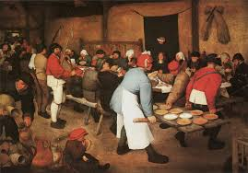
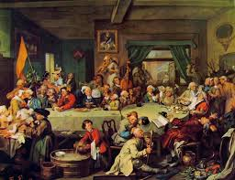
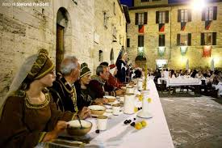

Slide 29
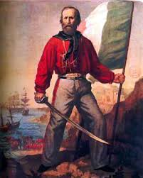
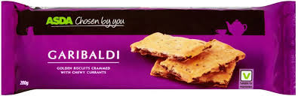
Garibaldi biscuits
Garibaldi biscuits: currants squashed and baked between two thin, oblongs of biscuit dough—a sort of currant sandwich
named after Giuseppe Garibaldi, an Italian general and leader of the struggle to unify Italy during the Risorgimento, who made a popular visit to Tynemouth and South Shields in England in 1854

Slide 30
Italian food in utopian fiction
News from Nowhere (William Morris, 1890)
Robert patted her head in a friendly manner; and we fell to on our breakfast, which was simple enough, but most delicately cooked, and set on the table with much daintiness. The bread was particularly good, and was of several different kinds, from the big, rather close, dark-coloured, sweet tasting farmhouse loaf, which was most to my liking, to the thin pipe-stems of wheaten crust, such as I have eaten in Turin.
News from Nowhere, 54

Slide 31
Bread and breadsticks
a value of sacredness
celebration of many rites (e.g. the holy communion,
the adjective good or the noun goodness - Italian phrase ‘buono come il pane’
Christian tradition, bread as the body of Christ.
the ‘holy’ bread/body of Christ
Gospel: Christ as “the bread of life” (John 6:35)
expression pane della scienza to indicate the idea of sharing ‘food’ among those who want to know and discover.
Dante’s Convivio: a meeting of table mates (convivial) who share the angels’ bread (knowledge/erudition). (same image in the works by Saint Augustine)

Slide 32
Bread and mankind
Bread-making and resides in the image of popular home knowledge, in the idea of knowing how to do or create things (an artisan / the patience that you need to construct something, and even in the act of making it)
employs the metaphor of bread-making in Shakespeare’s Troilus and Cressida as a device to point the patience of the lover and not of the loved one.
Bread does not exist in nature, but it is made by the man, it is the product of a complex process (cf. history of humankind, from the very beginning to the contemporary age)
In the Greek mythology, bread constitutes a food for men only since the gods do not eat it.
Polyphemus, the Cyclops that does not look like men, feeds on cheese only, according to the Odyssey (IX, 187).

Slide 33
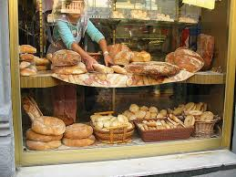
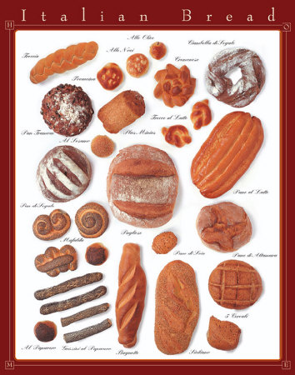
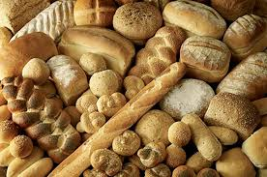

Slide 34
Italian phraseology related to bread
Andare come il pane
Avere il pane ma non i denti
Dire pane al pane (e vino al vino)
Non avere pane
Non è pane per i tuoi denti
Essere pane e vino
Sell like hot cakes Have the means but not the knowhow
Call a spade a spade
Be poor
Be more than one can handle / be beyond one’s means
Be hand in glove

Slide 35
other locutions “se non è zuppa è pan bagnato / mangiare pane a tradimento / misurare il pane / portare via il pane di bocca da qualcuno / non si vive di solo pane”,
Cf. Biblical quotation transformed into a proverb, from Matthew 4.4. and Luke 4.4. (‘Man does not live on bread alone’)

Slide 36
Turin breadsticks
Breadsticks (grissini) in the city of Chieri, on the outskirts of Turin
the story of the breadstick is tied to Antonio Brunero, a baker who first made this type of bread in 1679, for the new 9 year old King Vittorio Amedeo II, (the typical long and thin loaves of bread of that period were turned and stretched into pipes or sticks)
Rubatà: in Piedmontese (Italian regional dialect) ‘fallen/rolled’

Slide 37
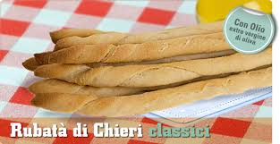
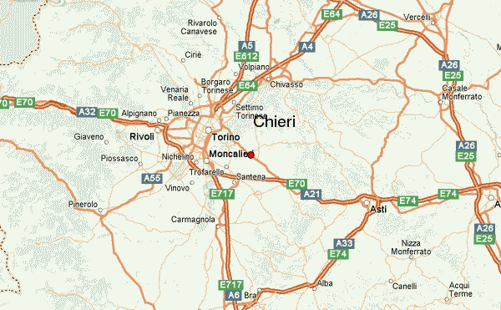

Slide 38
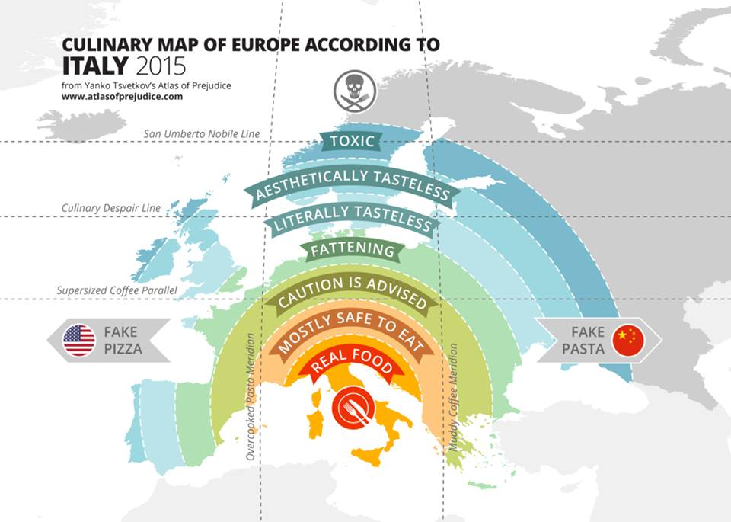
Italian food in the world

Slide 39
Food discourse through in the recipe types:
Structural patterns of recipes: title (a nominal group or a noun phrase), enticement (a full sentence with a ‘be’ clause followed by positive attitudinal words like “traditional, succulent or tempting”), ingredients (a sequence of nominal groups whose head is premodified by measuring words, sometimes with abbreviations: “90g (3 ½ oz) fresh white breadcrumbs”), method (clauses in the imperative mood, meanings of location, time and manner, with action-oriented verbs) and serving quantity (Eggins 2005: 68)
“recipe-writing is an art form that has changed over time, and as with menus, the changes are related to the writer’s assumptions about the relationship shared with the reader” (Lakoff 2005: 157)
food and meals “serve as a vehicle of bonding, affiliation, belonging, acceptance, and therefore esteem, as well as a means of self-actualization” (Perianova 2006: 23)

Slide 40
Italian food discourse as a genre
Two textual realisations of the recipe genre:
Recipes contained in advertising material freely available in British supermarket Safeway (1990s)
Recipes from a cookery book by celebrity chef Jamie Oliver (2005)

Slide 41
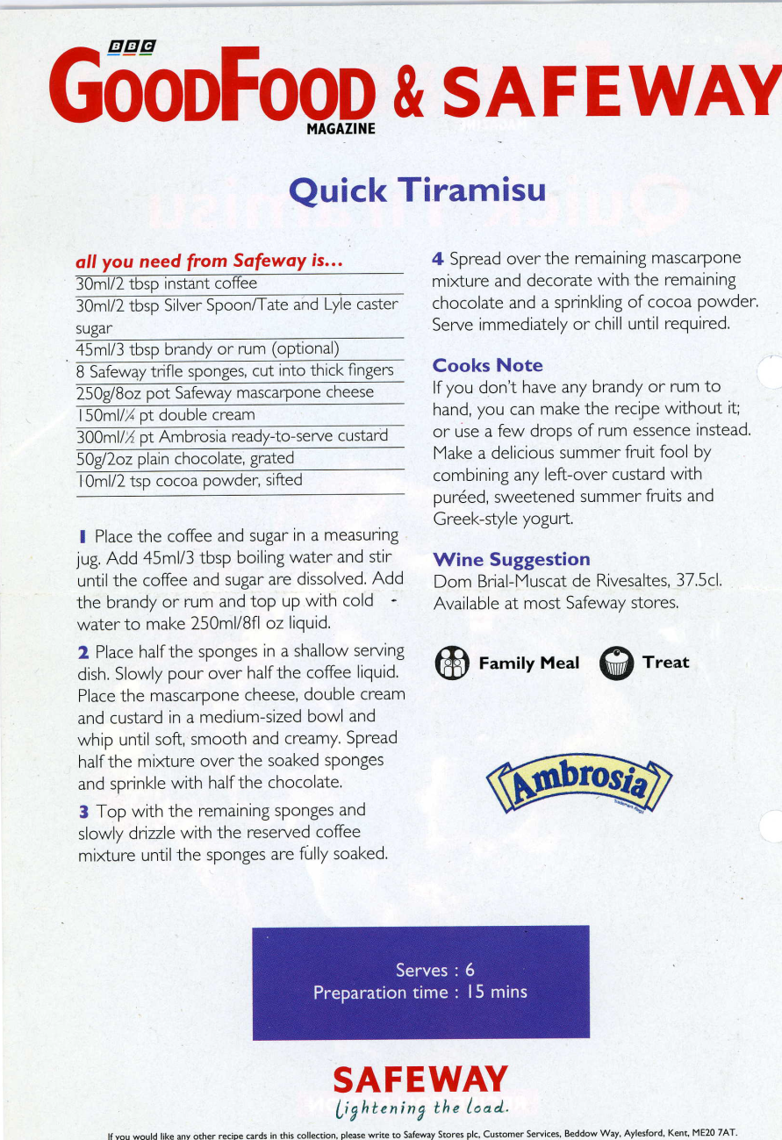
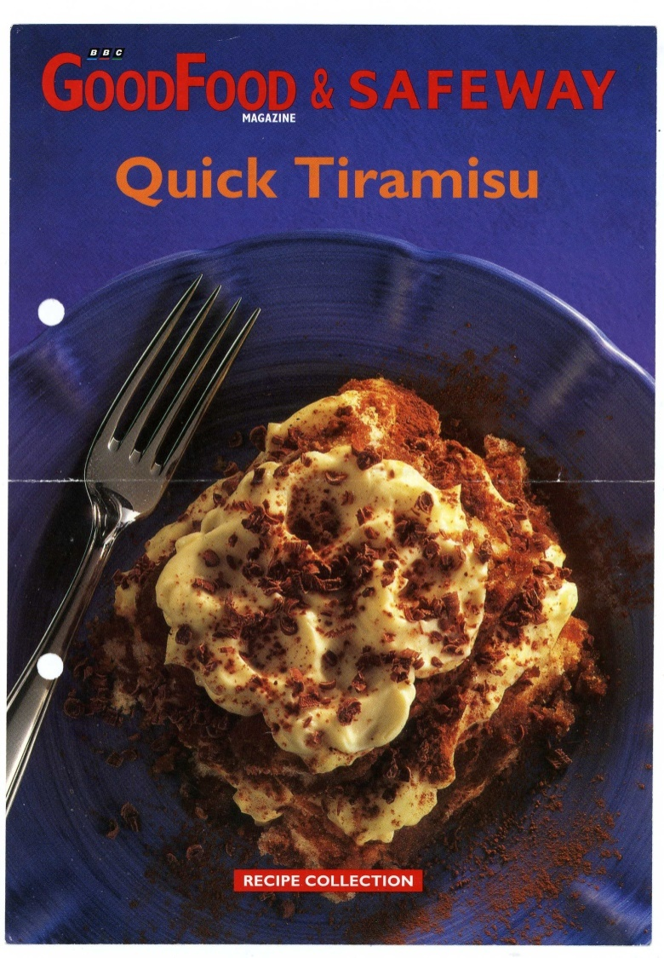

Slide 42
Stylistic features
Italian style and flair”
‘Italian feast menu’: fettucine with creamy spring vegetable sauce, oven-baked turkey with pesto crust, amaretti Sicilian cheesecake
We’ve gone all Italian (graphological chromatic attention-getting device)
Evaluative expressions: “a real family occasion”, “a wonderful Italian feast”, “real
Hyperbolic constructions (“all you need”)

Slide 43
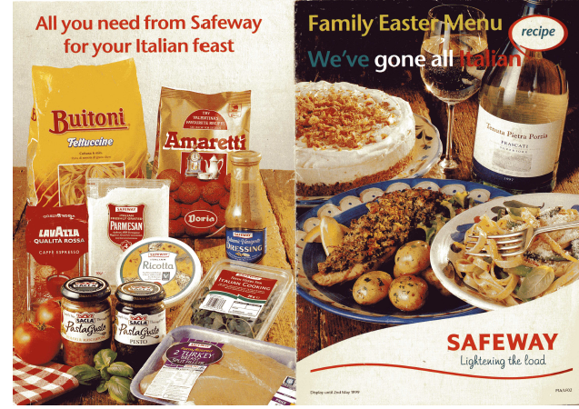
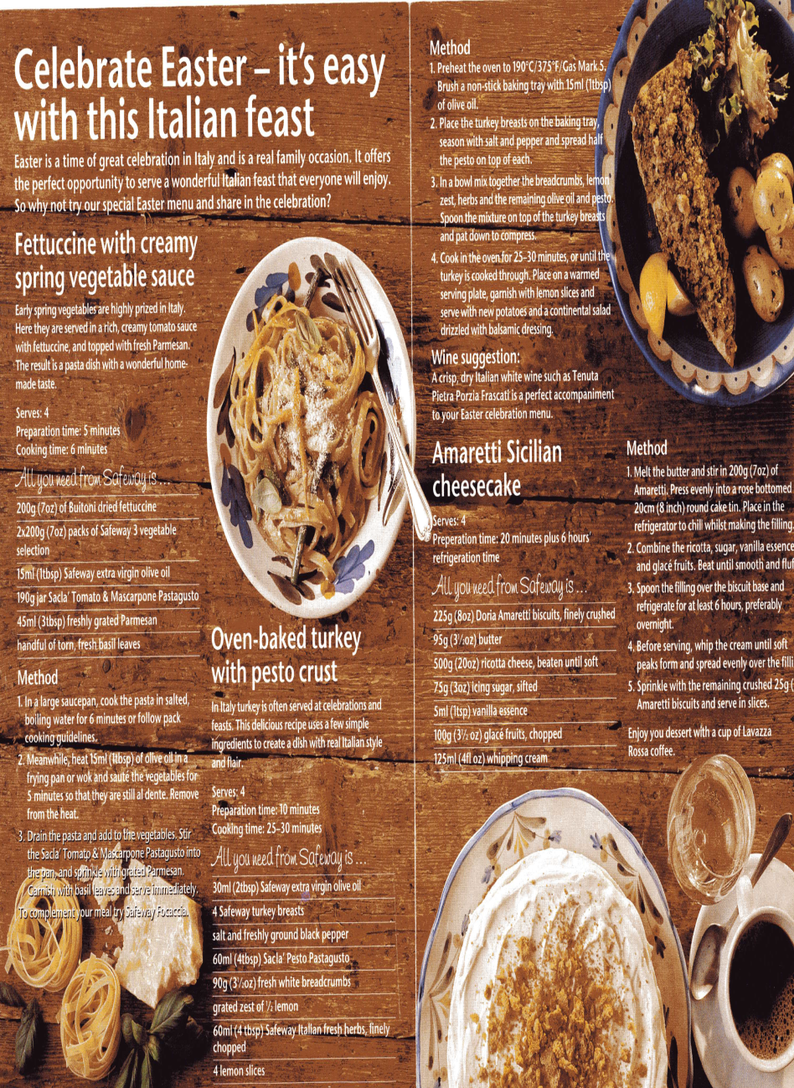

Slide 44
James (‘Jamie’) Oliver
Celebrity chef and restaurateur, MBE in 2003, author of TV cooking shows and publications
The Italian connection (Antonio Carluccio’s restaurant in Covent Garden)
Promotion of local products and food education
Jamies’ Italy (2005): a hybrid volume featuring recipes + professional photographs + commentaries (“My thoughts on” + name of a dish) + some autobiographical sketches
“Since I was a teenager I’ve been totally besotted by the love, passion and verve for food, family and life itself that about all Italian people have, no matter where they’re from or how rich or poor they might be” (Oliver 2005: viii)

Slide 45
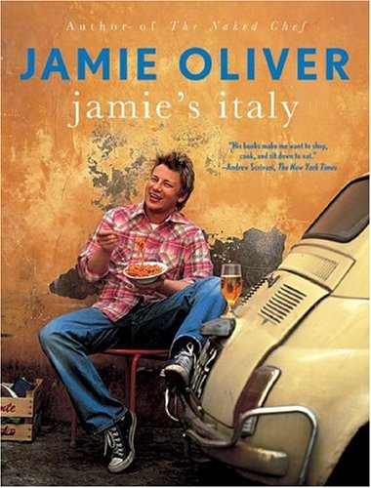
Jamie’s Italy (2005)
132 recipes, divided into these categories: antipasti/starters, street food and pizza, first courses (soups, pasta, risotto), insalate/salads, secondi/main courses (fish, meat), contorni/side dishes, dolci/desserts
Gricean maxims – quantities, times and methods
Identity of author (and reader)

Slide 46
Language
Informal register + specialised lexicon of gastronomy
Colloquial tone: “some real ballsy flavour” (p. 129, for the risotto recipe), “absolutely moreish” (p. 266, for the aubergine parmigiana)
Vocatives: “Ok, tigers”
Onomatopoeic indication “a good splash of olive oil” (p. 106)

Slide 47
Borrowings from Italian
Ingredients (“cavolo nero”, p. 70), names of dishes (antipasti, p. 260; chicken cacciatora, p. 222), cooking methods (“al dente”, p. 90)
Italian loanwords referring to people: “the poor old mammas have got used to bulking out soups easily by adding pasta, bread and beans” (p. 63)
Appellative ‘mamma’ or ‘nonna’ as terms of kinship providing stereotypical images of Italy

Slide 48
Person deictic forms
Onomastic terms as personal deictic forms: “Nonna Fangitta’s tuna” (p. 204), “Nada’s cake” (p. 294), “Nonna Giusy’s fish with couscous” (p. 207), or “Pasta Norma style” (p. 204)
“I haven’t got a clue who Norma is, but I’m sure she’s a good old girl!” (Oliver 2005: 88)

Slide 49
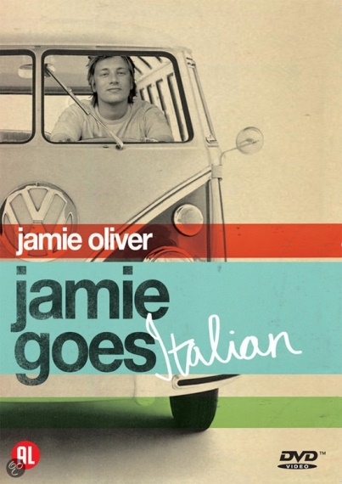
Use of personal pronouns
Tripartite use of pronouns: I / we / they
“we/us” (the British) versus “they/them” (the Italians) thanks to a mediating agent (“I”, Jamie Oliver)
“[flavours] very accessible to us back in Britain” (p. 116)
[in Jamie’s personal recipe for white risotto] “and if a local Italian turns his nose up, well, I don’t care, because in this chapter I consider myself a know-it-all” (p. 129)
title of the book as an indicator of identity appropriation and abrogation (construction of persona)
use of personal references driven by the power of implying and assuming (Jeffries 2010)

Slide 50
Other semiotic resources
Professional photographs by David Loftus and Chris Lerry
Images of stereotyped Italianness (rural landscapes, religious references, but also bloody images of wild game becoming high to add dramatic intensity)

Slide 51
Italian food discourse today
Ten days after the shooting I drove to Watlington to keep my appointment with joseph Lacy. The following day I spent the morning in my study making arrangements on the phone, and in the afternoon I walked to our local Italian food shop to collect ingredients for our picnic. It was much the same as before – a mozzarella globe, ciabatta, olives, tomatoes, anchovies, and for the children, a no-frills pizza margherita. The next morning I packed the food into a rucksack along with two bottles of Chianti, mineral water and a six-pack of Cokes.
Ian McEwan, Enduring Love, 1997, p. 220

Slide 52
Conclusions:
“a cuisine is a richly structured cultural object, with its component flavor elements and its set of combinatory grammatical principles, learned early and deeply” (Jurafsky 2014: 184)
Identity / authenticity / circulation
Food discourse in-between neophobia and neophilia (Perianova 2010)
“human identity as a continual work in progress, constructed and altered by the totality of life experience” (Lakoff 2005: 142)

Slide 53
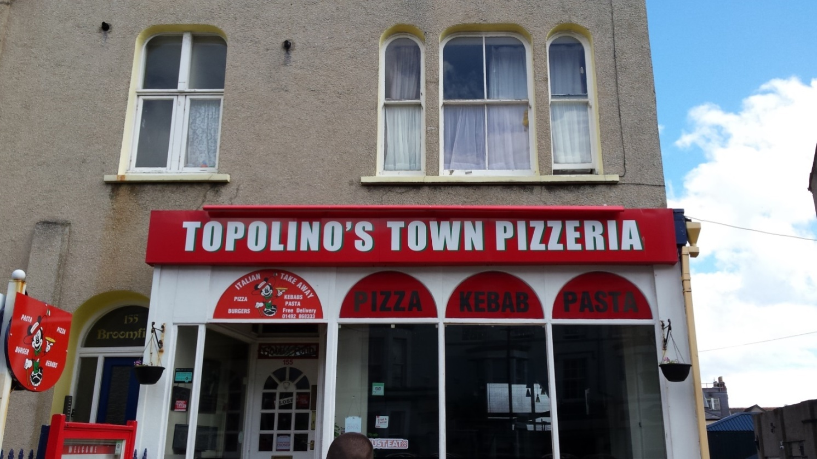
Thank you for your attention

